Slide 1



Cannabis Conversations:
Doing Business In Norwich
March 10, 2022

Slide 2
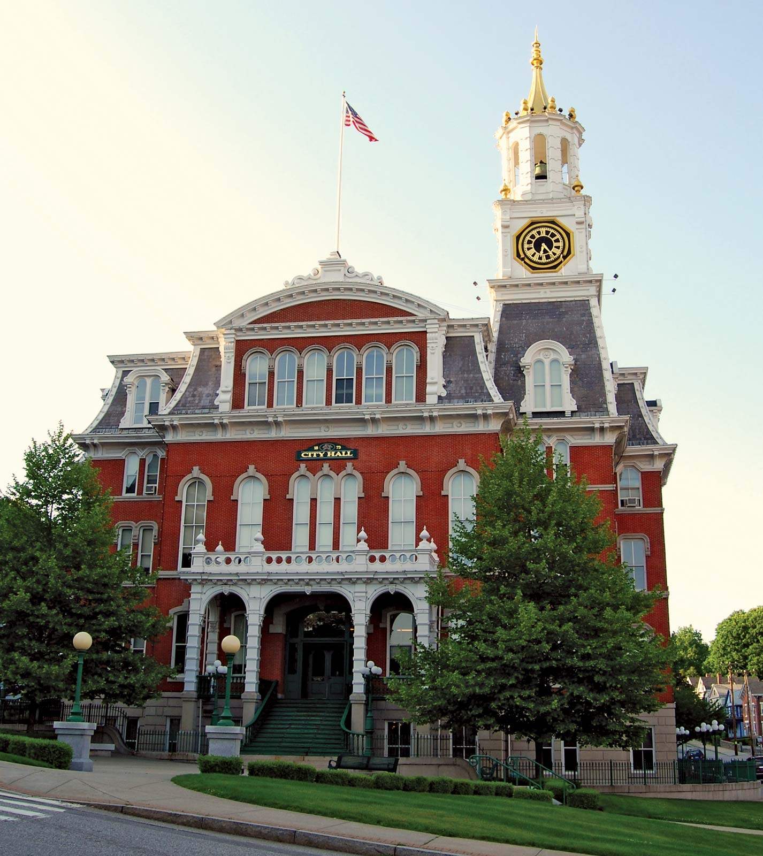
Benefits of doing business in Norwich
A local government that is business- oriented
Norwich Community Development Corporation (“NCDC”), an economic development group to advocate for businesses
An inventory of affordable locations available
Competitive electric and gas utility rates
An able and willing workforce

Slide 3
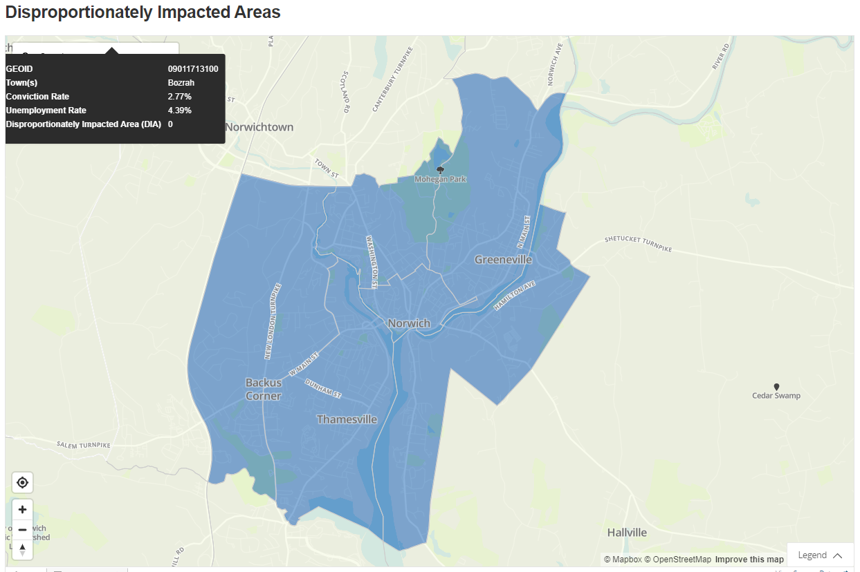
Do you qualify for social equity?
Requirements:
Had an average household income of less than 300% of the state median household income over the 3 tax years immediately preceding the date of the application, and
Was a resident of a disproportionately impacted area for at least 5 of the 10 years immediately preceding the date of the application or was a resident of a disproportionately impacted area for not less than 9 years prior to attaining the age of 18.
You may qualify for priority access to cannabis licenses if you meet these requirements.
Norwich
Source: https://data.ct.gov/stories/s/Disproportionately-Impacted-Areas-Identified-for-P/8nin-pkqb/

Slide 4
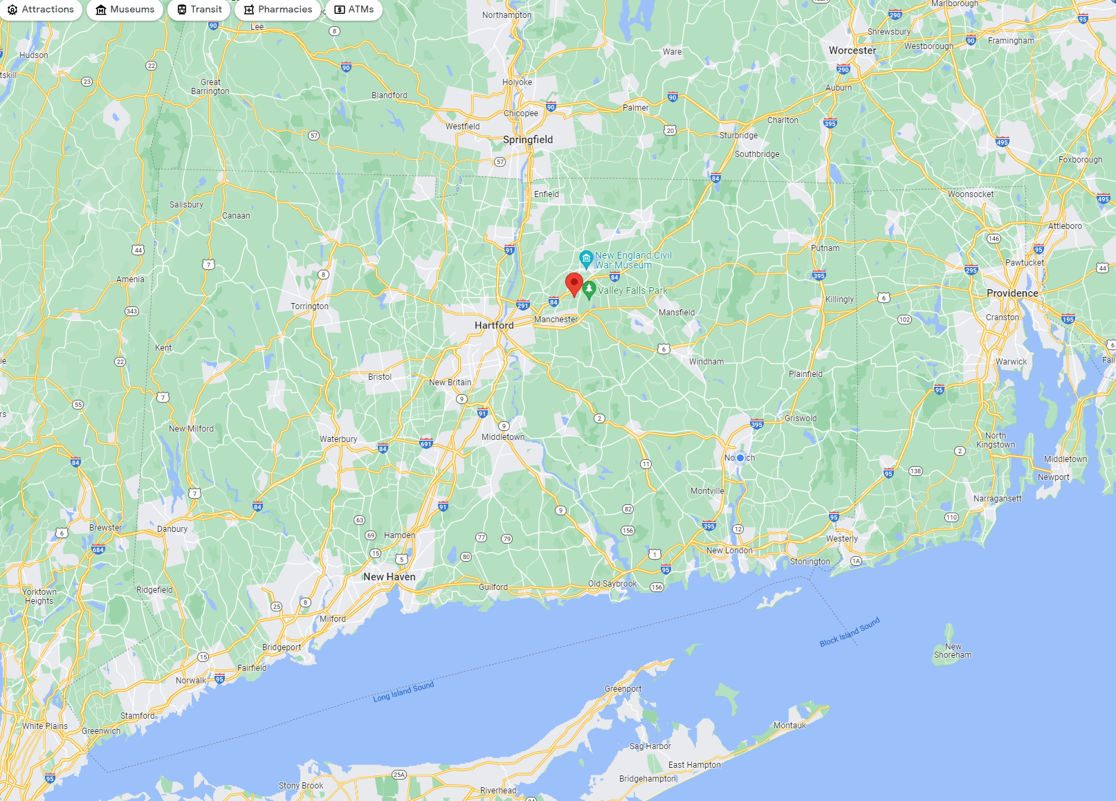
Town Zoning & Ordnance Changes
As Reported to Department of Consumer Protection
Approved – 12
Moratorium – 38
Prohibited – 15
Unknown - 104
Norwich!

Slide 5
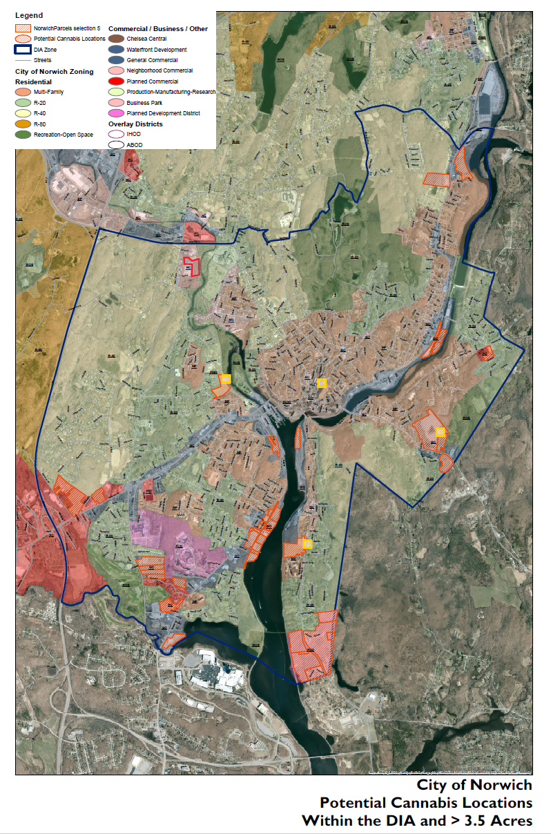

Zoning for Cultivation and Retail Possibilities
Cultivation
Retail

Slide 6
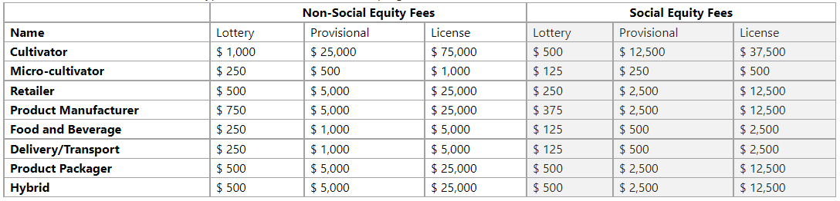
Licenses available and fees

Slide 7
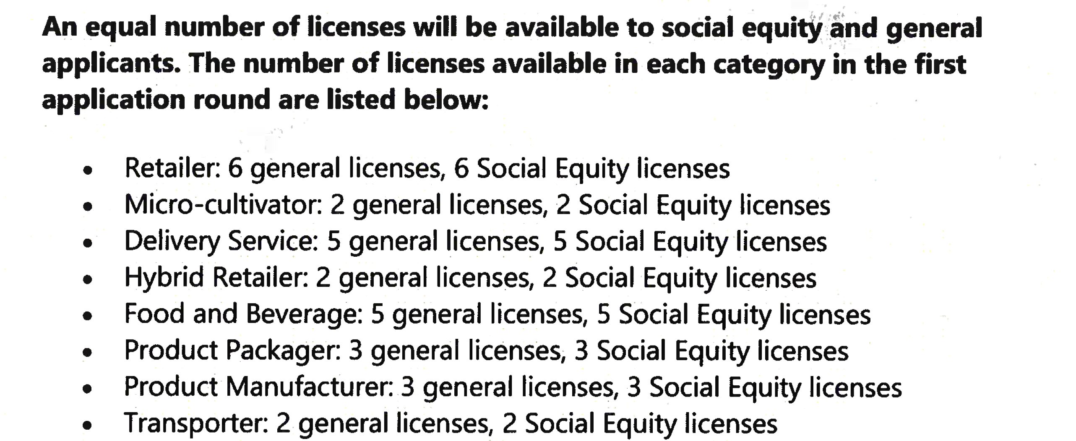
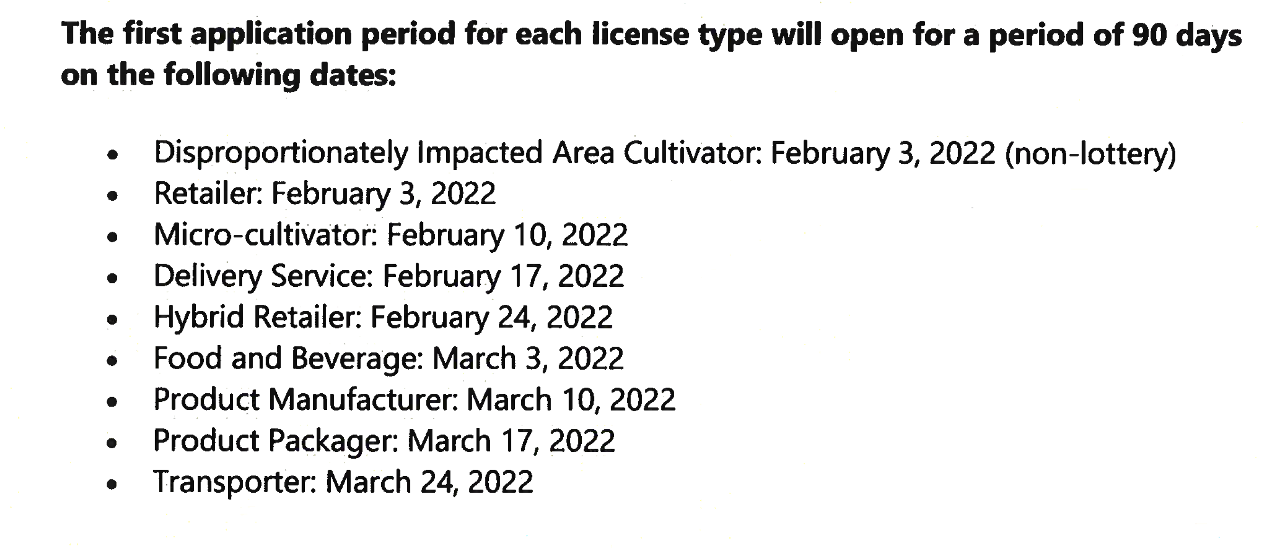
Licenses
numbers
Application
Windows

Slide 8
License Applications to date
March 10, 2022
Credential Type | Social Equity Council Lottery | General Lottery
ACDS: ADULT-USE CANNABIS DELIVERY SERVICE | 2 | 16
ACFB: ADULT-USE CANNABIS FOOD AND BEVERAGE MANUFACTURER | 0 | 3
ACME: ADULT-USE CANNABIS MICRO-CULTIVATOR | 4 | 22
ACRE: ADULT-USE CANNABIS RETAILER | 11 | 48
AMHF: ADULT-USE CANNABIS MEDICAL HYBRID RETAILER | 0 | 2
Update
As of
March 17, 2022

